Slide 1

Delivering Practical Knowledge, Backed by Leading-Edge Research for More than a Century
Extension Committee on Organization and Policy
The Cooperative Extension System/ECOP National Office is headquartered in Washington, DC at the Association of Public and Land-grant Universities (APLU)
Notes:
In over a century since its creation, the nationwide Cooperative Extension System’s educational and outreach network has made significant contributions to American agriculture, communities and quality of life — particularly in rural areas.

Slide 2


the Smith-Lever Act of 1914 went into effect, creating an educational force that would change the Nation forever:
More than
The Cooperative Extension System
Notes:
The Smith–Lever Act of 1914 established a system of Cooperative Extension Services, connected to the land-grant colleges and universities, in order to inform people about current research developments in agriculture, home and family life, public policy/government, economic development and 4-H. The legislation helped farmers and rural families learn new agricultural techniques, food preservation, and economics by the introduction of home instruction and demonstrations.

Slide 3
the National Agricultural Research, Education, and Teaching Policy Act of 1977 augmented the Cooperative Extension System to include Historically Black Colleges and Universities and to serve as never before
More than
Four decades ago,
historically underserved audiences
Notes:
.

Slide 4
Congress passed a law to add Tribal Colleges and Universities to the Cooperative Extension System to reach communities of
More than
A quarter century ago,
original North American land descent
Notes:
.

Slide 5

President Jimmy Carter said, “to live as a productive citizen, the Extension Service had a on me.”
“major beneficial effect

Slide 6
Today
32,000 University-based and local-level Educators and Agents.
2.8 million volunteers.
Reaching every county, parish, and borough in the Nation.
Land-grant University connection to research-based, community-focused, and trusted information.
Notes:
Extension plays a significant role in non-formal educational outreach across the Nation and beyond in rural, urban, and suburban settings. With its unprecedented reach — an office in or near most of the nation's 3,000+ counties — Extension Agents and Educators help farmers and ranchers achieve greater success, assist families with nutrition and healthy living, and prepare today’s youth to become the leaders of tomorrow.
Through a strong USDA partnership and federal, state and local funding, this vast public/private partnership enhances the reach, diversity, equity and inclusion of this extensive network of outreach education and engagement, serving as a trusted resource for youth, families, farms and communities.

Slide 7
Notes:
Land-grant university system, original 1862 legislation providing funding for land-grant universities, 1890 legislation providing funding for Historically Black Universities, and 1994 legislation which funded Native Colleges and Universities.

Slide 8

Extension agriculture programs remain critical
to state’s economies:
Managing farm financial risks
Dealing with drought and disasters
Promoting Integrated Pest Management
Supporting Rural and Urban agriculture
Advancing economic and workforce development

Slide 9
traditional Extension activities such as livestock and cooking are still part of 4-H positive youth development programs, but so are:
Aerospace, robotics & geospatial technologies
Computer science & multimedia
Nutrition, health & safety
Citizenship & community service
Leadership & public speaking

Slide 10
modern Extension programs are still promoting healthy
lifestyles and families through food safety, as well as:
Health & nutrition education for limited resource groups, or those with chronic illnesses.
Money management techniques
Relationship and parenting skills
4-H and positive youth development
Successful aging education
Childcare provider training

Slide 11
Extension Agents and Educators are still helping to build and revitalize our economy and communities with programs:
Helping businesses grow
Encouraging entrepreneurship
Helping communities identify marketable resources

Slide 12
Extension programs are vital
to current events:
Rural and Urban agriculture
Diversity, Equity, and Inclusion
Health
Economic and Workforce Development
Climate
Broadband Access and Digital Skills
Positive Youth Development

Slide 13



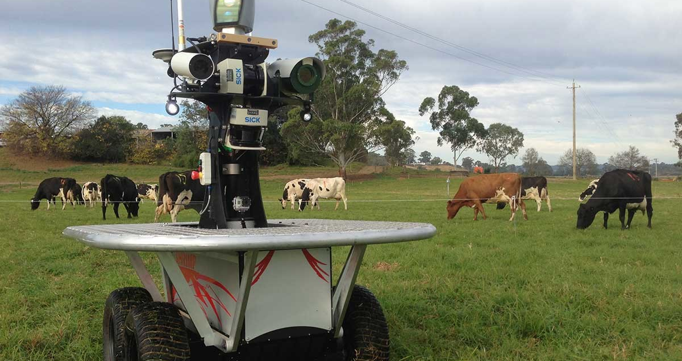

Notes:
This vast System of non-formal educational outreach meets the needs of people and communities, where they are.
The Cooperative Extension System of tomorrow will continue to respond and adapt to an ever-changing technological, environmental, and community landscape to bring the latest science-based information and outreach education to people across the nation and beyond.

